Slide 1

Data Transformation IV

Slide 2
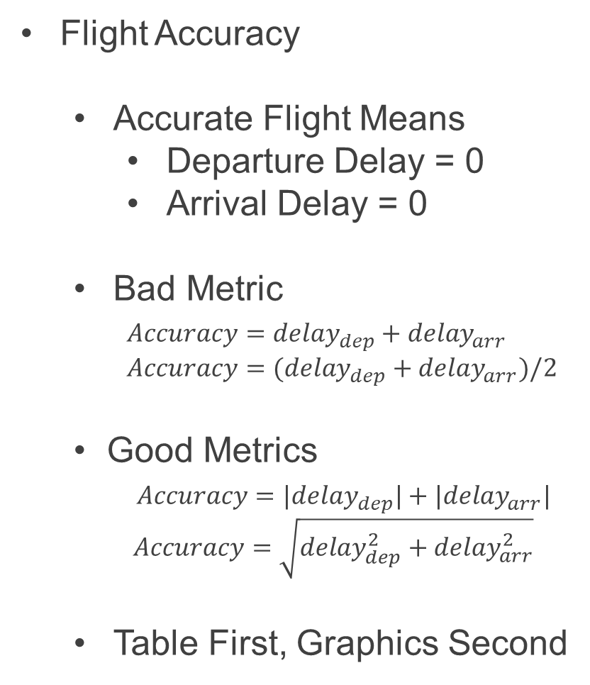
Case Study
Flight Accuracy
Accurate Flight Means
Departure Delay = 0
Arrival Delay = 0
Bad Metric
$Accuracy=delay_{dep}+delay_{arr}$
$Accuracy=(delay_{dep}+delay_{arr})/2$
Good Metrics
$Accuracy=|delay_{dep}|+|delay_{arr}|$
$Accuracy=\sqrt{delay_{dep}^{2}+delay_{arr}^{2}}$
Table First, Graphics Second

Slide 3
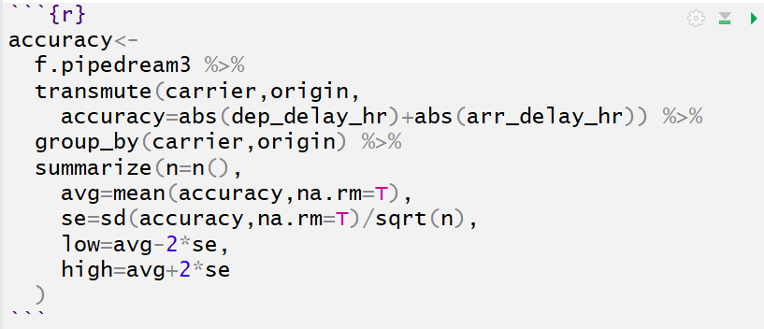
Case Study
Summary Table
Step 1: Accuracy Variable
Step 2: Grouping
Step 3: Summarize Info
Mean
Standard Error
Lower Bound (95% CI)
Upper Bound (95% CI)

Slide 4
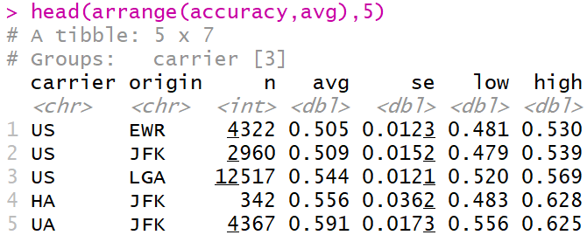
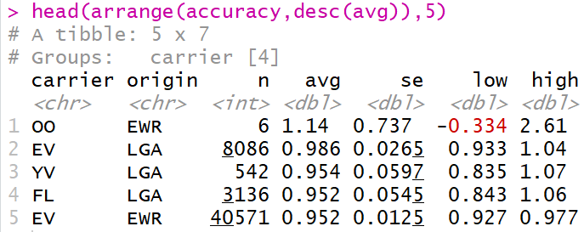
Case Study
Sorted by Average Accuracy
Best Carriers/Origin
Worst Carriers/Origin

Slide 5
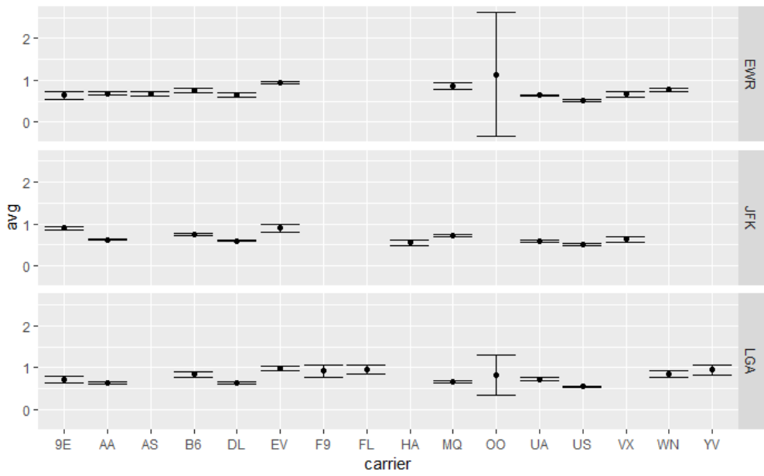
Case Study
95% Confidence Intervals
Carrier “OO” Creates a Visual Problem Due to Small Sample Size

Slide 6
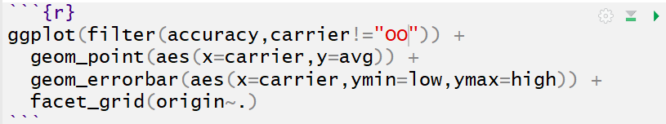
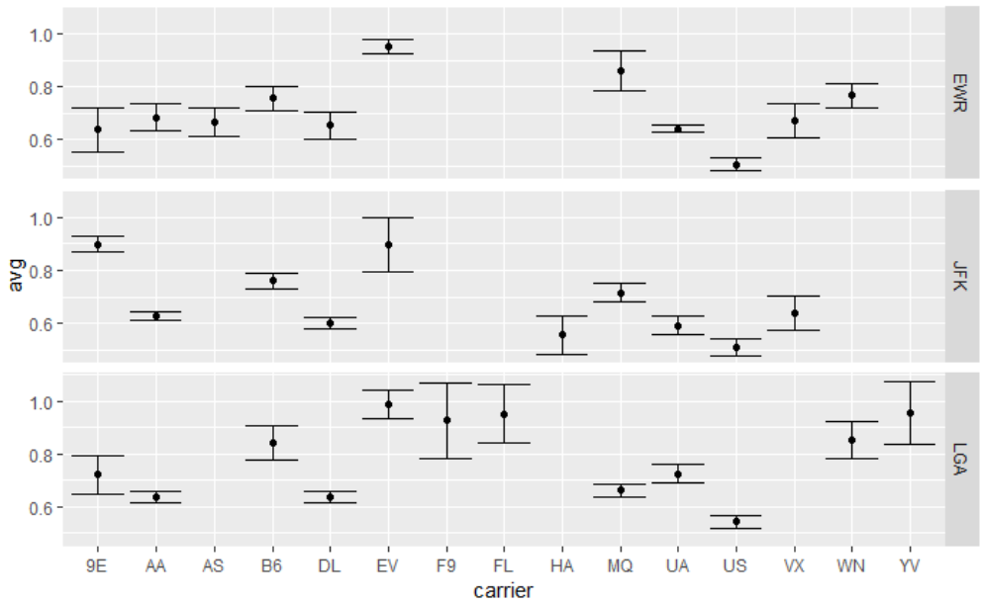
Case Study
95% Confidence Intervals

Slide 7
Closing
Disperse and Make Reasonable Decisions

